Slide 1
Open MRS – DSS Coding & Alerts
CSC868 – Group 1

Slide 2
Group 1 Members
Robert Bierman
Kay Choi
Steven Gimeno
Jason Lum
Ying Kit Ng
Bianca Uy
Victor Woeltjen

Slide 3
Introduction and Overview
Physicians need not only a repository of information but also assistance in efficiently processing that information.
Decision support systems help analyze data in a relevant fashion
By creating a “rule” based DSS where physicians themselves (and others) can write these rules in a simplified manner allows effective use of DSS
Integrated into OpenMRS to allow access to patient data and simplified messaging in the unified system

Slide 4
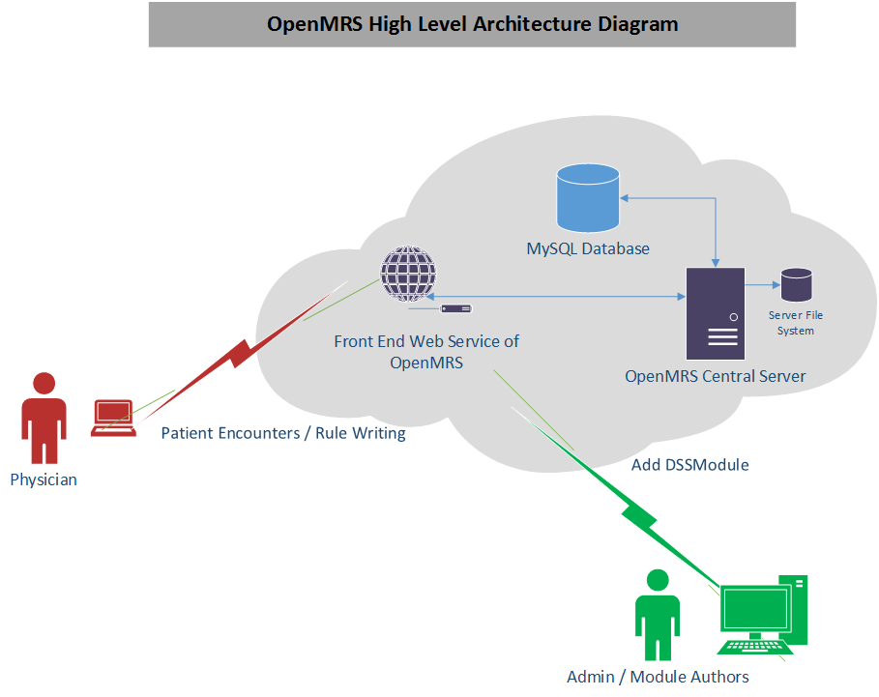
Architecture Use Case Overview

Slide 5
Typical Use Cases

Slide 6
Demo

Slide 7
Architecture

Slide 8
Development

Slide 9
Skills

Slide 10
Communication

Slide 11
Teamwork

Slide 12
Schedules

Slide 13
Conclusion

Slide 14
Q & A

